Slide 1


Slide 2

Clear View
Soft Skills Are:
Skills, abilities and traits that pertain to personality, attitude, and behavior
Soft Skills Are Not:
Formal or technical knowledge

Slide 3

What Industry Wants
Skill sets that include:
Oral and written communication skill
Critical thinking ability
Problem-solving resourcefulness
Ability to work productively on a team

Slide 4
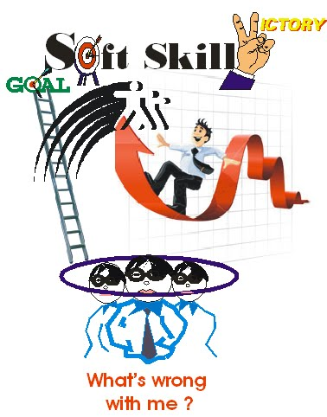
Soft skill for successful career
Soft skill is the ability required and expected from persons for finding a suitable job, its maintenance and promotion

Slide 5

Importance of soft skill
Soft skill are very important
To handle interpersonal relations
To take appropriate decisions
To communicate effectively
To have good impression and impact to gain professional development

Slide 6

Communication skill as soft skill
Communication skills form the corner stone of soft skill

Slide 7
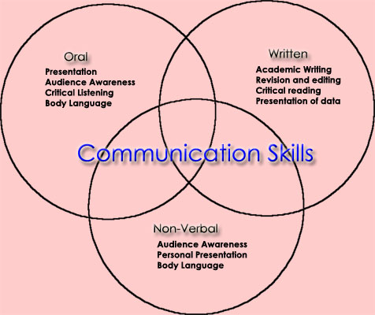
Every human being has to essentially & effectively communicate with others
Effective communication is the hallmark of one’s education

Slide 8
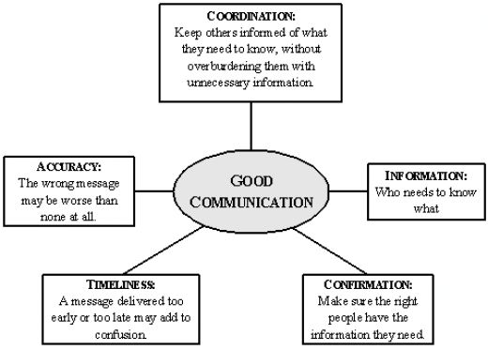

Slide 9
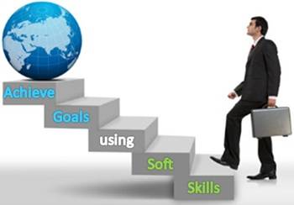
The ability to speak fluently using the right word in the right order is an good communication
Message using appropriate vocabulary and syntax form effective communication

Slide 10
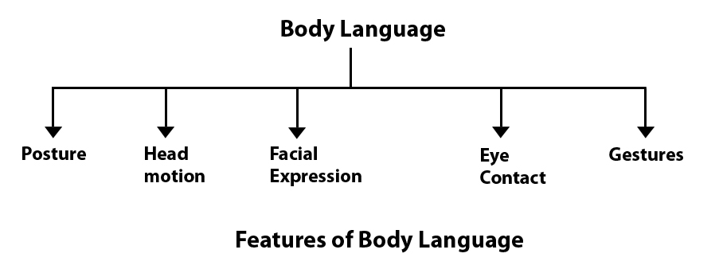
BODY LANGUAGE
Face is the index of the mind and it clearly displays the persons interest

Slide 11
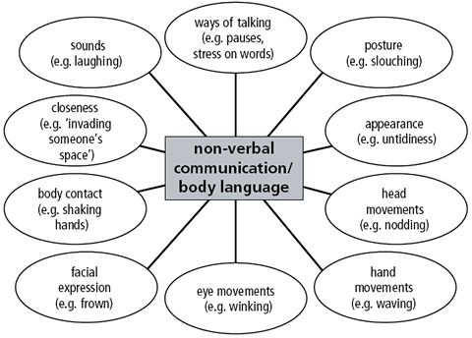
Body language presents to the audience what we feel & think about the particular matter
Ex: Nodding one’s head

Slide 12
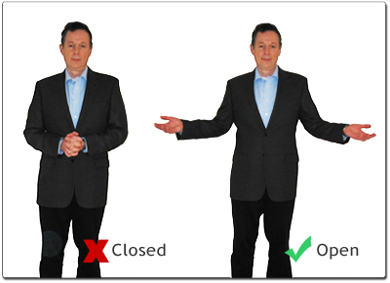
Body language (e.g. arms crossed, standing, sitting, relaxed)
Emotion of the sender & receiver (e.g. speaking clearly, enthusiastic)

Slide 13

Written communication Skill
Writing evaluates a person’s proficiency indications, spelling grammar etc…
Errors committed while writing circulars, reports & agenda considerably spoil the image of the writer

Slide 14

Good visual presentation using graphics, color, balanced design layout- adds so much to written communication.
Keep handouts and other written materials for your presentation.

Slide 15
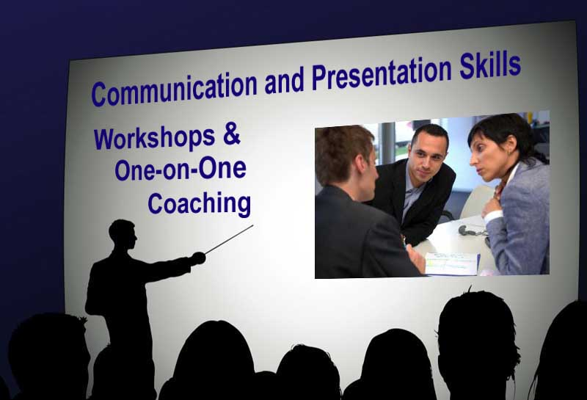
Presentation Skills
Presentation skills include planning, preparation & delivery of the message
Making a formal speech is one form of presentation
Presentation skills can be broadly categorized into physical oral, & electronic

Slide 16

Success in life depends on presenting ideas in an appropriate manners
Look at the eyes of audience & speak in a natural, conversational voice
Appropriate voice will make the presentation effective and interesting.

Slide 17


Ask for feed back from your audience about your presentation & change accordingly
In presentation especially, stop occasionally to ask the audience understand what you have said

Slide 18

TEAM WORK
People of either gender, different age groups, qualification, status & skills work as a team with a common objective of accomplishing the task
The success of any organization largely depends on in the coordinated efforts of its employees
It mainly refers to the agreeableness & co-operation among the team members

Slide 19

Professional ethics
Professional ethics is the need of the hour in USA
When a person is at the work spot, he must think of his work only
He must put his heart & soul into the work
Each employee is a organic part of the organization & must strive to contribute his mite to the successful functioning of the organization

Slide 20
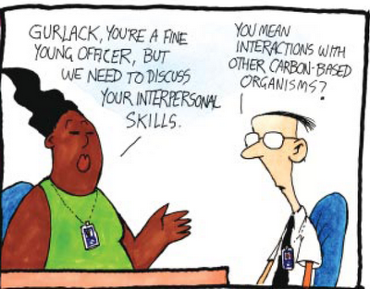
Interpersonal skill

Slide 21
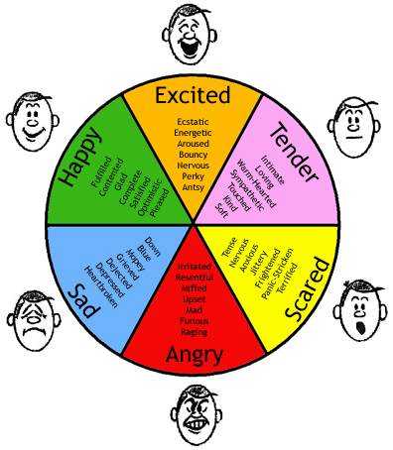
Interpersonal Skills
Man is a social animal & his success in life largely depends on his relationship & interaction with others
We must respect the views & sentiments of others.
When we want to differ their views, we must very politely give hints to them without wondering their feelings

Slide 22

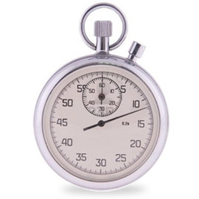
Time Management
Prioritize the work & schedule your time accordingly
Impotent work should be allotted more time & taken up first

Slide 23
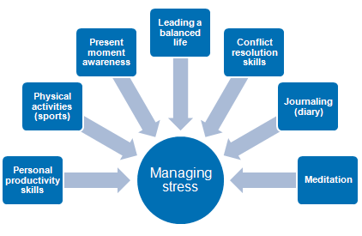
Stress Management
Change Your Focus
School yourself to wake and get ready, not for work, but for your day.
On the drive to work, listen to music, humor – anything that isn't related to work.

Slide 24
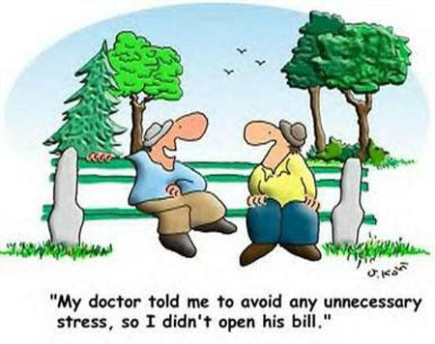
Stress Management
Take an alternate route to work. The change in scenery will help you stay alert to the road and keep your mind off the job.
Plan your work and work your plan. Devote every paid minute to your job. Deviate from your work plan only when absolutely necessary.
Take your allotted breaks. Remember: the opposite of stress is relaxation. Don’t work through lunch or coffee breaks. This also means don’t think or talk about work during your breaks.

Slide 25
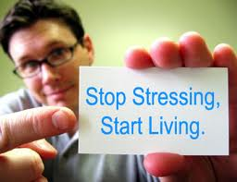
Stress Management
Just as you plan your work, plan your time away from work.
At day’s end, leave work behind you and focus on your plans for the evening. Work to live.
Relaxation away from work means less stress… and a better day tomorrow!

Slide 26

Stress Management
Instead of coffee, drink water, juice, or electrolyte infused drinks. Dehydration often is the cause of fatigue.
Coffee and soft drinks that contain caffeine may seem to “keep you going”, but in reality they add to stress and don’t keep your body hydrated.
Practicing Yoga will considerably reduce the physical, emotional & mental stress of an individual

Slide 27


Leadership skills
Leaders, executives & managers need to be very clear about what they expect from others
Trust your self
Keep smiling
Share & stay together

Slide 28

Leadership skills
Always learn new things
Accept responsibility for your self & your actions
Look at problems & challenges
Be grateful always
Men make history and not the other way around. In periods where there is no leadership, society stands still. Progress occurs when courageous, skillful leaders seize the opportunity to change things for the better.

Slide 29
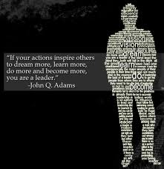

Slide 30
THE END!

